Slide 1
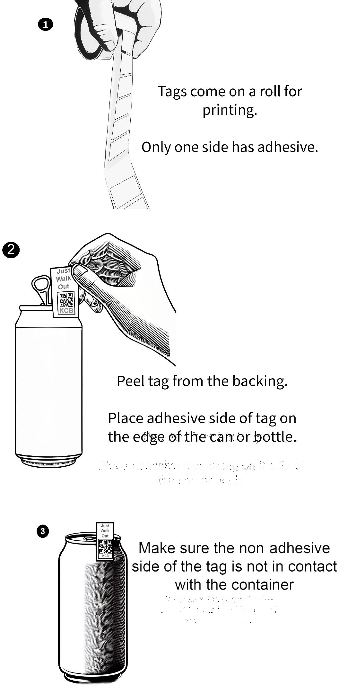

Slide 2
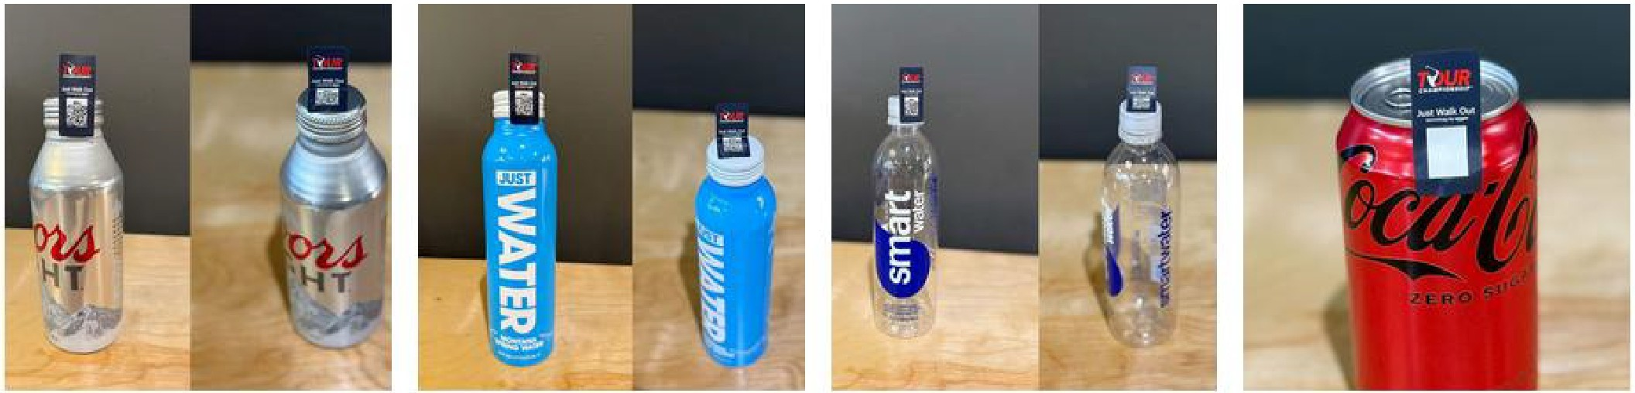
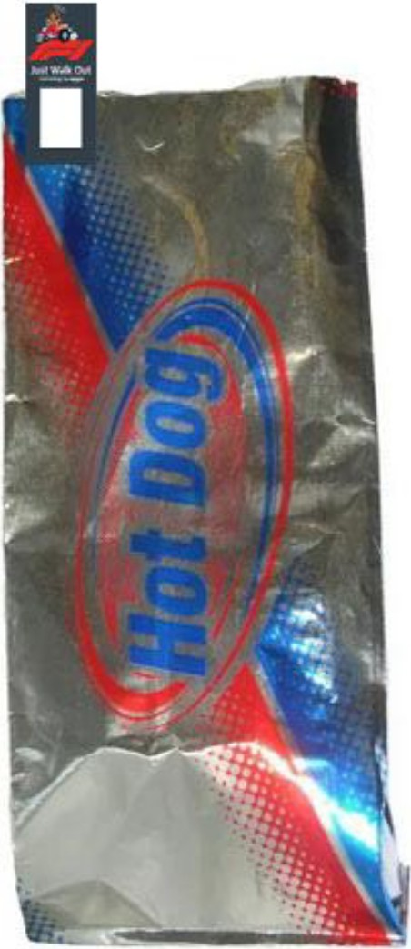
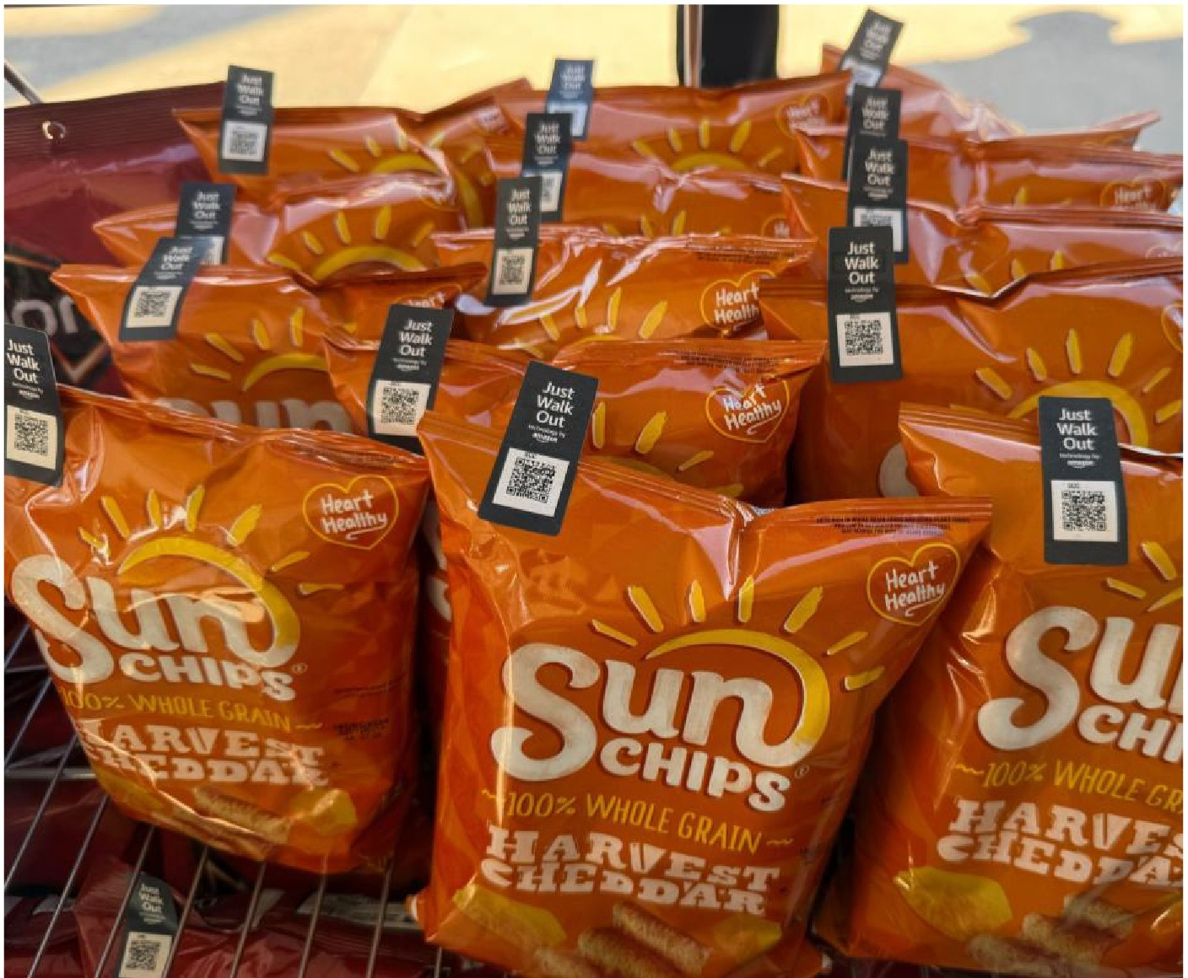
Food & Beverage application
The Midas Fl!ag-Tag makes tagging Food & Beverage products easy. Examples of how products in thiis category car, be tagged are included below.
Metal bottle tag applied to t1he cap either on the side or top of tlile product.
Metal bottle tag applied to the cap either on the side or lop of the product.
Plastic bollle tag applied !o the cap either on the side or top of the product.
Metal can with tag, applied to,the sicie, wltlil the anten,rna portion of the tag off and above lhe top of the can.

